Slide 1

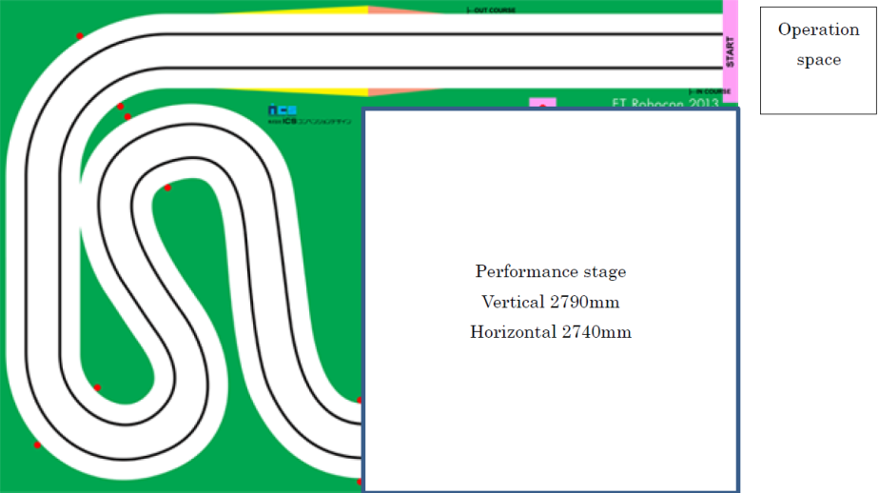
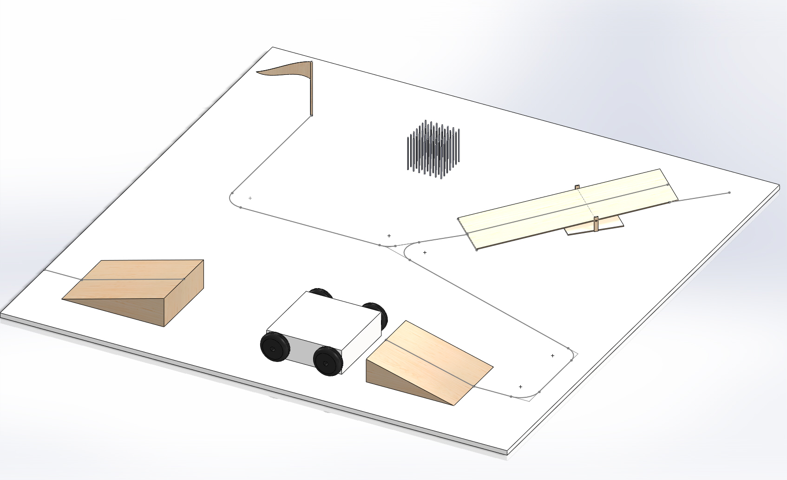
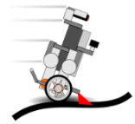

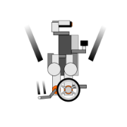
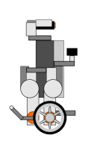


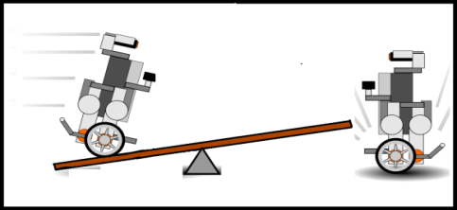


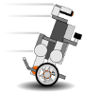
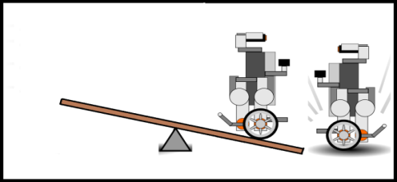


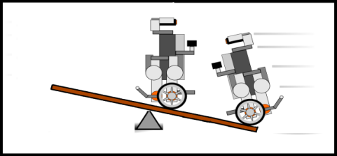
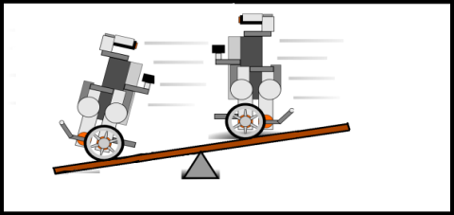
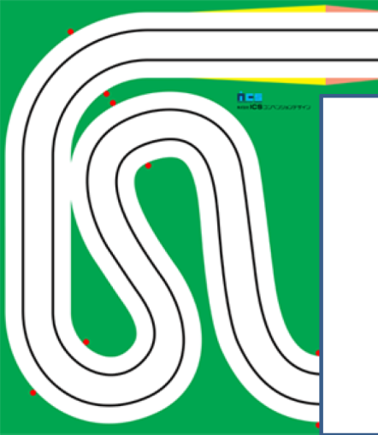
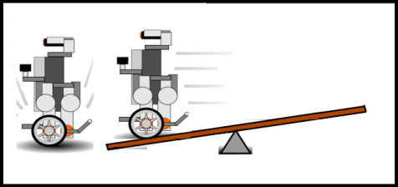
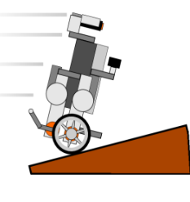
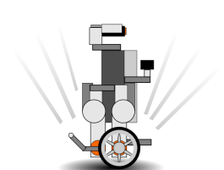
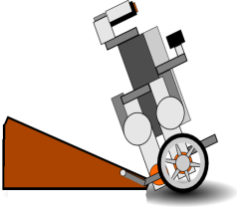
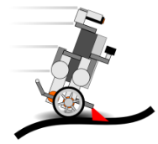
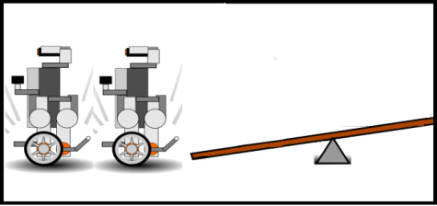
1. ARCHITECT PERFORMANCE
SETUP CONFIGURATION
1
6
FINALE
I. Up & Down Ramp
Length:
Height:
Steepness:
I. Synchronized Line-Track:
Performance Stage
NXT1 and NXT2 line-track towards corner of the stage.
II. Seesaw
Down Ramp: 5% steep
II. Synchronized Parking:
NXT1 and NXT2 park at the end of the performance, simultaneously.
Seesaw: 5% steep
III. Communications
NXT1
ROVER
NXT2
5
RESCUE MISSION
Slave
Slave
Slave
6
5
2
NXT2
NXT1 on seesaw
Master
NXT1
1
LINE TRACKING
Navigation Line
I. Start from Outer Course
NXT1 tips seesaw
NXT1 starts from the outer course. It will perform two short-cuts through the basic stage.
4
3
II-Shortcut1. Outer to Inner Track
NXT1 cuts across to outer track and realigns line-track using inner-track line.
Communication Station
(Raspberry Pi)
NXT1 & NXT2 on seesaw
II-Shortcut2. Cut through Outer track
NXT1 cuts through inner and outer track then tracks using inner-track.
NXT1 & NXT2 tip seesaw
2
START PERFORMANCE
3
BRIDGE CROSSING
4
LINE TRACKING
I. NXT1
NXT1 enters performance stage through outer line and moves towards the up-ramp.
NXT1 leaves seesaw
II. NXT2
I. Go on ramp
II. Land on rover
III. Balance on moving rover
VI. End of bridge cross
V. Move down ramp
NXT2 parked with tail down waiting for NXT1 to rescue.
NXT2 rescued

Slide 2


2. REQUIREMENTS ANALYSIS
1: REQUIREMENTS ANALYSIS
3:. NON-FUNCTIONAL REQUIREMENTS
The following is high-level requirement for the architect performance based on the concept design stage.
<<Requirement>>
Efficient Development Structure
Requirements are further divided into functional and non-functional requirements.
<<Requirement>>
Successful Architect Performance
<<Requirement>>
Configuration Management
<<Requirement>>
Parallel Development Process
<<Requirement>>
Efficient Development Process
<<Requirement>>
Efficient Verification Process
<<Requirement>>
Efficient Development Process
<<Requirement>>
Excellent model documentation
<< Requirement>>
Not disqualify
<<Requirement>>
Successful Basic Stage
<<Requirement>>
Successful Performance Stage
Use of SVN
Use of Simulink Projects
<<Requirement>>
Use Model-Based Design process
<<Requirement>>
Use Rapid-Prototyping process
<<Requirement>
Use a tool to log test signals for verification
2: FUNCTIONAL REQUIREMENTS
3.3
Use of MATLAB & Simulink
Use of Simulink Target Hardware Support Package
Develop and use Bluetooth data logging tool
<< Requirement>
Complete performance within 2 mins
<<Requirement>>
Successful
LINE-TRACKING
<<Requirement>>
Successful
BRIDGE CROSSING
<<Requirement>>
Successful
RESCUE MISSION
<<Requirement>>
Successful
FINALE PERFORMANCE
3.5
3.6
<<Requirement>>
Sufficient navigation track design
<<Requirement>>
NXT1 shall go up and down the ramp.
<<Requirement>>
Rover to move NXT1 from one ramp to the other ramp
<<Requirement>>
NXT1 to tip over the seesaw and rescue NXT2
<<Requirement>>
NXT1 and NXT2 must line-track in synchronously.
<<Requirement>>
NXT1 and NXT2 must perform parking synchronously.
Build custom track for navigation
<<Requirement>>
Minimize time to finish basic stage.
Goal: < 30 seconds
<<Requirement>>
Finish architect performance in
1 min and 30 seconds
<<Requirement>>
NXT shall line track while on a ramp.
<<Requirement>>
Rover must move straight from one ramp to other
<<Requirement>>
NXT1 and Rover must communicate with each other
<<Requirement>>
NXT1 and NXT2 must communicate with each other
<<Requirement>>
Efficient & reliable LINE-TRACKING algorithm
Element Technologies
$$φ$$
Blind run for shortcut
Ambient Light Elimination
Switching PID Parameters
Current Angle Estimation
Speed Control
Step Detection
Step-off Ramp Detection
Rover drive control
Distance Sensor detection
Bluetooth communication
5.1
5.1.A
5.1.B
5.2
5.1
5.4
PG.5
7.1
7.1
6
Please refer to the following sections for details.

Slide 3


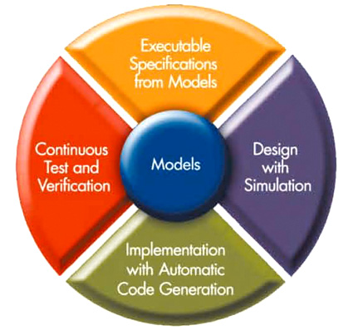
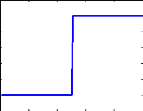
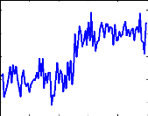
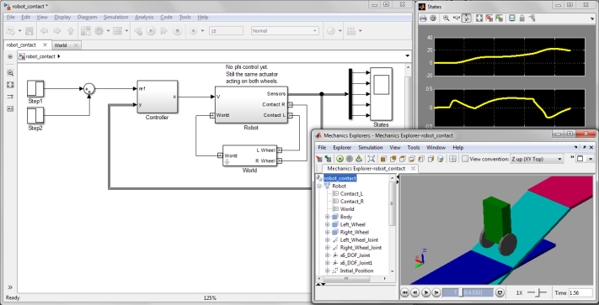

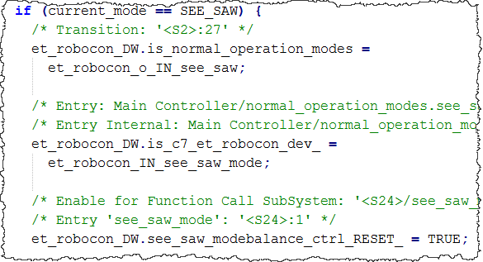

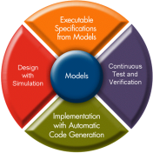
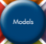
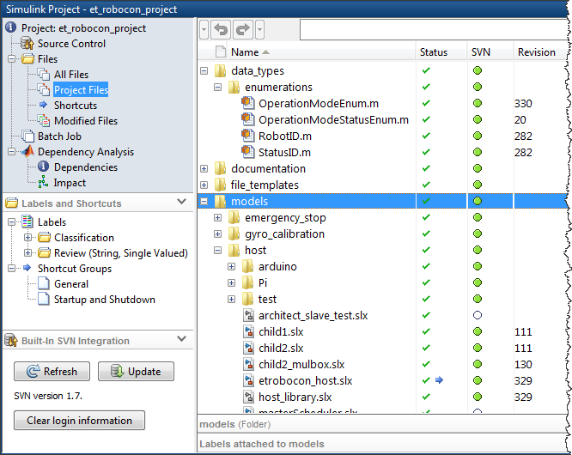
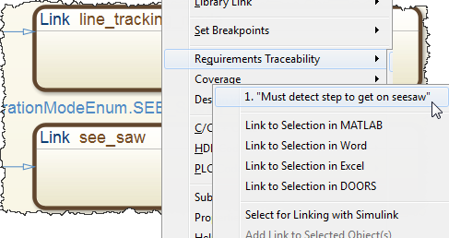
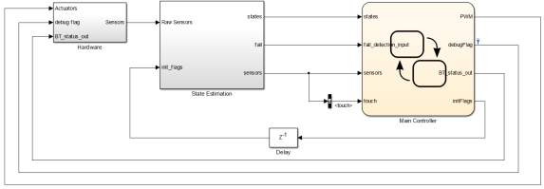
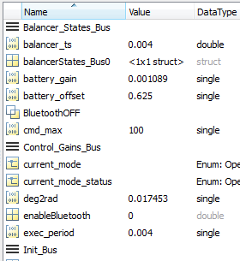
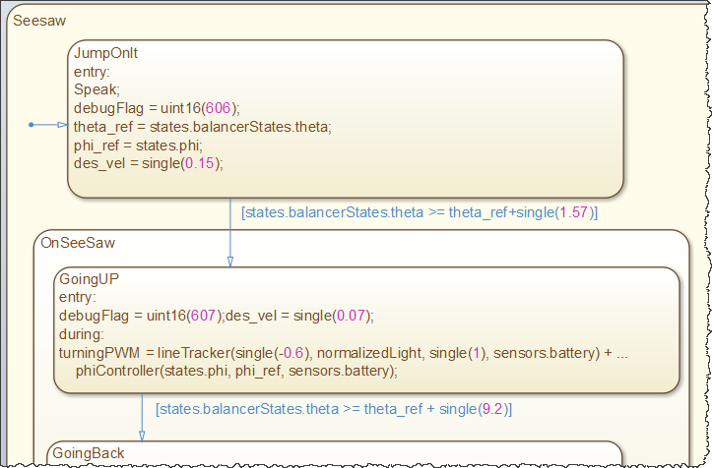
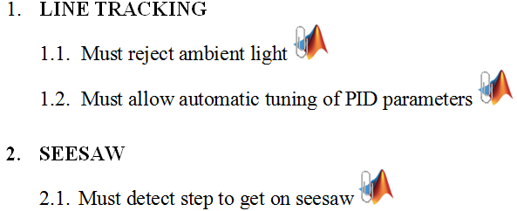
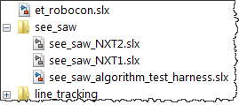
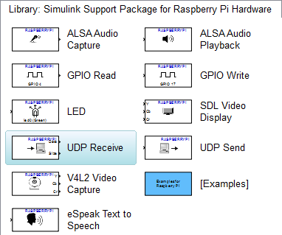
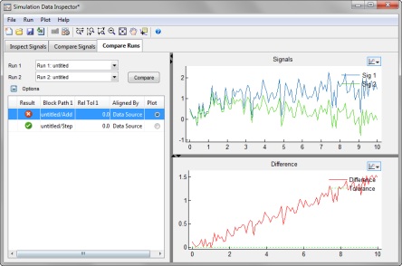
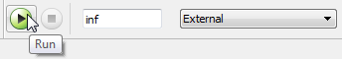
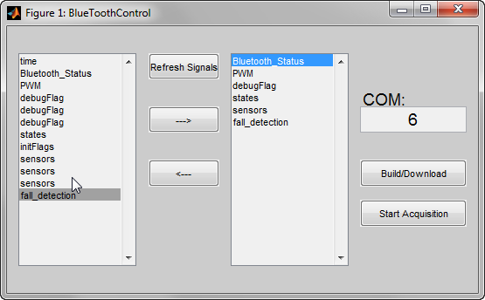
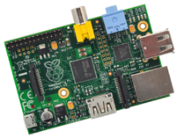

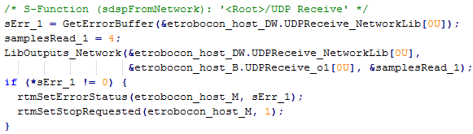
3. DEVELOPMENT PROCESS AND TOOLS
1: DEVELOPMENT ENVIRONMENT
2: MODEL-BASED DESIGN
We can perform Component-level design of control algorithms and test them by creating artificial inputs in Simulink.
The Model-based Design (MBD) approach is centered around a model of a real system.
All design changes can happen at the model level. All associated tasks can be easily updated with the changes to the model.
We use the MATLAB and Simulink environment throughout the entire development process.
These tools facilitate:
Requirements linking
System-level design
Model architecture
Configuration management
Data management
Algorithm Design
Rapid Prototyping
Verification and Validation
SYS1
Then, we can perform System-level integration to test the performance of algorithms in the entire system.
We can create a physical model of the LEGO Mindstorms NXT and test our control algorithm design in simulation.
SYS0
SYS1
SYS2
SYS3
Finally, we can automatically generate code from these models onto embedded systems and verify the algorithm behavior.
Accelerating the pace of engineering and science.
Simulink Model
C Code
3: PROJECT MANAGEMENT
Requirements can be linked to Simulink models using the Simulink Verification and Validation product.
4: SIMULINK MODEL MANAGEMENT
Stateflow for modeling complex control logic using flow graphs and state machines,
Models are represented by using Simulink block diagrams.
Requirements
document
MATLAB files
Model
Simulink libraries and model reference help with concurrent development in separate files.
Simulink models
Link
We promote concurrent model development by using Subversion (SVN) for source control. Simulink Projects is used to integrate SVN into the MATLAB environment.
Main model
Data dictionaries and model variants to store, modify and switch model configurations.
Library models
(dependencies)
5: RAPID PROTOTYPING
6: MODEL TEST AND VERIFICATION
External mode:
Visualize data
Tune parameters
while a model is running on embedded hardware.
We can automatically generate code from Simulink models and build them onto low-cost embedded systems using Simulink Support Packages for Target Hardware.
This enables us to reuse simulation algorithms and automatically build them on the performance embedded devices:
LEGO Mindstorms NXT
Arduino Mega 2560
Raspberry Pi
Bluetooth data logging:
Custom tool to collect sensor, state and logic data while running a model on embedded hardware.
Select signals for logging
Run-time Display
Tune parameters
Model
(Host PC)
Hardware
Simulink Library:
Contains driver blocks
View and compare runs in Simulation Data Inspector
Receive run-time data
C Code
Embedded target communicates with host computer using TCP-IP over USB.

Slide 4
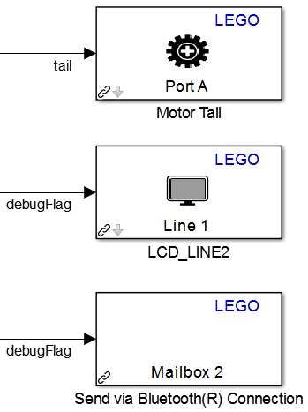
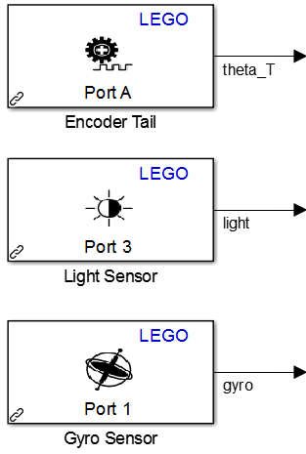
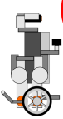
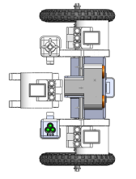
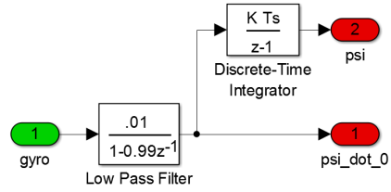

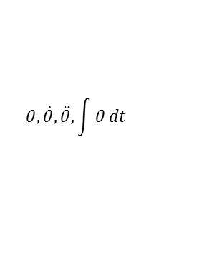
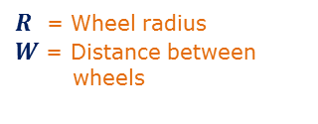















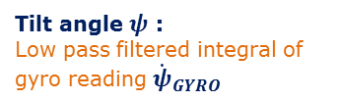

4. NXT MODEL ARCHITECTURE
1: MODEL OVERVIEW
Simulink® model built on LEGO Mindstorms NXT
2: HARDWARE
Simulink Model
Create RXE File
et_robocon.slx
Robot sensors and actuators are accessed through the Simulink Support Package for LEGO Mindstorms NXT.
Generate C Code
GNU ARM
toolkit
$$\hat{x}$$
C
Automatic code
generation
Automatic build and download through Cygwin
Hardware
I/O
State
Estimation
Controller
Actuators
Motor PWM
LCD debug display
Bluetooth send
Utilities in controller
Line Track
Balance
…
Bridge
Crossing
Rescue Mission
Sensors
Motor encoders
Light/Gyro/Ultrasonic
Buttons
Battery
Bluetooth receive
Tasks
Each task is developed independently and placed in a separate project folder under source control
Generated code translates Simulink driver blocks into nxtOSEK functions
3: STATE ESTIMATION
$$\hat{x}$$
4: CONTROLLER
C
C. Task Management:
Tasks are executed using a Track Mode List.
This is a vector of OperationModeEnum enumerated data type.
Each task outputs its status. This is done with an enumeration of type OperationModeStatusEnum.
Converts sensor values into states. States used for balancing and line tracking.
A. Control Logic:
Unless there is an emergency, the controller will execute all defined tasks sequentially.
GYRO READINGS
${\dot{ψ}}_{GYRO}$ = Robot tilt rate
$$ψ, \dot{ψ }$$
$R$ = Wheel radius
$W$ = Distance between wheels
Normal Operation
ENCODER READINGS
$θ_{L}$ = Left motor angle $θ_{R}$ = Right motor angle
start
Do Task
start
entry:
start task
exit: next task
Example Track Mode List: 1. LIGHT_CALIBRATION_UP 2. GYRO_CALIBRATION
$$φ, \dot{φ}$$
Read Gyro
Read
Encoders
$$θ,\dot{θ},\ddot{θ},\int{θ}dt$$
task complete
3. LINE_TRACKING
$${\dot{ψ}}_{GYRO}$$
$$θ_{L},θ_{R}$$
Side view
Top view
task aborted or robot falls
E-Stop
start
Start
Filter and compute
$$ψ$$
Tilt angle $ψ$ : Low pass filtered integral of gyro reading ${\dot{ψ}}_{GYRO}$
entry: stop moving
push
button
entry: start moving
Status = IN_PROGRESS
$$ψ,\dot{ψ}$$
Compute
$$θ \text{and} φ$$
B. Task Component:
Each task must interface with the main controller using the following specification.
end of line
lost line
Finish
Failure
$$θ,φ$$
Controller
entry: stop moving
Status = COMPLETED
entry: stop moving Status = ABORTED
Compute other states
Turning angle $θ$ and Steer angle $φ$ :
Task
interface
$$θ=\frac{1}{2}\left(θ_{L}+θ_{R}\right)+ψ$$
$$\hat{x}$$
Inputs
States
Sensors
Task
Component
Outputs
Motor PWM
Bluetooth command
Task status
Sensor initialize flags
Debug flags (for LCD)
To next task
To E-Stop
All states:
$$ψ,\dot{ψ},θ,\dot{θ},\ddot{θ},\int{θ}dt,φ, \dot{φ}$$
$$φ=\frac{R}{W}(θ_{R}−θ_{L})$$
4. SEE_SAW
5. PARKING
If the final task is marked complete, the robot will loop back to the first task.
All state estimation integrals are reset to zero using initialize flags from the controller.

Slide 5
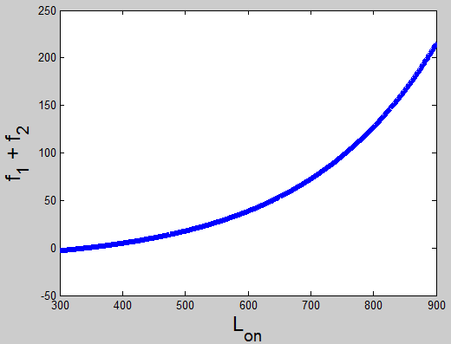





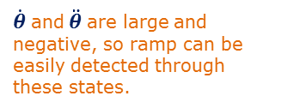


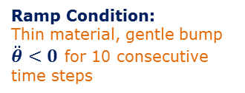




















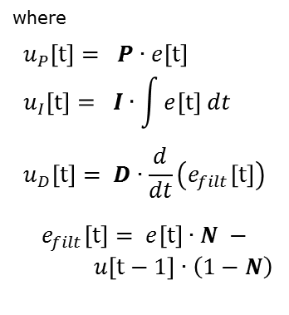



5. CONTROL ALGORITHMS
$$φ$$
1: LINE TRACKING
2
1
2: PHI CONTROL
start
3
Phi control is used when:
There is no line
Line tracking is difficult
In case (2), phi control and line tracking are combined with a weighted average.
$$φ$$
Track is divided into Zones
Consists of 2 algorithms:
Light processing
Track zone control
$$φ$$
5
Performance Stage
Get . from states
$$φ_{desired}$$
$$u_{LEFT}$$
4
Proportional feedback control
$$\dot{φ}$$
A: LIGHT PROCESSING
$$u=K_{φ}∙(φ_{desired} −φ)$$
$$u_{RIGHT}$$
Poll Light Sensor
6
$$u=100∙\frac{u}{V_{battery}}$$
Scale by battery voltage + saturate
$R$ = Wheel radius
$W$ = Distance between wheels
start
Read On
$$u_{MAX}= 100 \\ u_{MIN}=−100$$
entry:
turn light on
read $L_{on}$
$$\dot{φ}=\frac{R}{W}\left(u_{RIGHT}−u_{LEFT}\right)$$
end
Read Off
Sensors
B: TRACK ZONE CONTROL
3: BALANCING
start
Balancer states do not perform any lateral ($φ$) correction, so only 5 out of 8 states are used.
Balancing commands can be added to line tracking or proportional $φ$ control.
entry:
turn light off
read $L_{off}$
Track Zone:
Determined based on distance and angle traveled by the robot.
$${x= \left[ θ ψ \dot{θ} \dot{ψ} \ddot{θ} \right]}^{T}$$
Select Balancer states
Poll Light Sensor
State Estimation
Filter Light Values
$$x$$
$$θ, φ$$
PID Control Law:
$$u=K∙(x_{desired} −x)$$
Full-state feedback control
From experimental data
Filter
Values
Light sensor values
K is a 1x5 matrix
K is defined in each task and can be changed every time step.
$x=f_{1}\left(L_{on}\right)+f_{2}\left(L_{on}\right)−L_{off}$
Find Track Zone
$$u=100∙\frac{u}{V_{battery}}$$
$f_{1}\left(L_{on}\right)=a_{1}e^{b_{1}L_{on}}$
$$L_{on}, L_{off}$$
$$e=L_{desired}−L_{norm}$$
Scale by battery voltage + saturate
$f_{2}\left(L_{on}\right)=a_{2}e^{b_{2}L_{on}}$
Lookup
Table
bias
$$u\left[t\right]= u_{P}[t]+u_{I}[t]+u_{D}[t]$$
$$u_{MAX}= 100 \\ u_{MIN}=−100$$
PWM commands lie in the range -100 to 100, and are replicated to both left and right wheels.
Select Control Gains
where $$u_{P}\left[t\right]= P∙e\left[t\right] \\ u_{I}\left[t\right]= I∙\int{e[t] dt} \\ u_{D}\left[t\right]= D∙\frac{d}{dt}\left(e_{filt}\left[t\right]\right)$$
$$e_{filt}\left[t\right]= e\left[t\right]∙N −$$ $u\left[t−1\right]∙\left(1−N\right)$
end
$$L_{norm}$$
4: RAMP DETECTION
Ramp and Seesaw have different thicknesses, so their impact conditions are determined separately.
Impact conditions are found through experiment.
Control
Gains
Approach:
Robot is moving toward the ramp and must detect it.
Compute Forward and Turning Speeds
Lookup Table
Impact:
Large backwards force upon contact with ramp.
Black, Edge and White from calibration
DETECT!
1
$$v, ω$$
$$\dot{θ},\ddot{θ}$$
Balancing Algorithm
$\dot{θ}$ and $\ddot{θ}$ are large and negative, so ramp can be easily detected through these states.
Ramp Condition:
Thin material, gentle bump
$\ddot{θ}<0$ for 10 consecutive time steps
0.5
0
Edge
+ Bias
To Balancing Algorithm:
Recovery:
Need to provide a large velocity command to overcome bump and gravity.
Black
White
Forward and turning speeds are reference states in balancing controller.
Seesaw Condition:
Thick material, sharp bump
$\dot{θ}<−4$and $\ddot{θ}<−60$
Bias value modified based on track zone
Line tracking is turned off during the Zone 4 shortcut.

Slide 6












6. COMMUNICATIONS
1: COMMUNICATIONS OVERVIEW
2: BLUETOOTH WITH RASPBERRY PI
3: BLUETOOTH WITH ARDUINO
Raspberry Pi is the host.
All Bluetooth communication between robots is done through the host.
Uses the Simulink Support Package for Raspberry Pi Hardware
Uses the Simulink Support Package for Arduino Hardware
Receive status messages
+
Broadcast commands
Simulink Model
Generate C Code
gcc
Create Executable
Simulink Model
Generate C Code
avr-gcc
Create HEX File
Raspberry Pi
(HOST)
Automatic code
generation
Automatic remote Linux Build: SSH over Wi-Fi
Automatic code
generation
Automatic build and download
Driver blocks for Raspberry Pi used:
Communications: UDP Send, UDP Receive
Push button to start model: GPIO Read
Driver blocks for Arduino used: Communications: Serial Send, Serial Receive Rover Control: Analog Input, Continuous Servo Write
UDP to Bluetooth conversion using serialPort_serv and serialPort_client
Serial to Bluetooth conversion using Bluetooth Silver Mate hardware
Rover
(Arduino Mega 2560)
NXT1
NXT2
4: HOST MODEL
Simulink® model built on Raspberry Pi
Each robot has an Enable Flag
0 : No communication 1 : Enable Bluetooth
5: MESSAGING
Status/Command Messages:
Robots receiving messages are represented by a RobotID enumerated data type.
Status and command messages are unsigned integers (1 byte) of StatusID enumerated data type.
See the example Stateflow chart below for usage of INIT, SEND and BYE messages.
etrobocon_host.slx
UDP Message Protocol: Raspberry Pi
UDP Recv
NXT1
Enable Flags
Simulink model etrobocon_host.slx is automatically built on Raspberry Pi.
ABC
Len
Message
PI
PL
EF
UDP Recv
NXT2
Push Button
Message length (in bytes)
Background process serialPort_serv loaded at startup on Raspberry Pi
INIT command only:
PI: Probe Interval
(in milliseconds)
PL: Probe message length (in bytes)
EF: Enable flags (in decimal form)
Logic
(State Machine)
UDP Utilities
Control Switch:
A: 1 is data (SEND) 2 is control (INIT/BYE) B: Robot ID
1 = NXT1 2 = NXT2 3 = Arduino
4 = NOT USED C: Bluetooth Mailbox ID
(for data validation)
UDP Recv
Arduino
INIT()
SEND()
BYE()
start
Receiving is periodic
(every 0.1 s)
INIT command:
Server creates one client for each enable flag
Sending is asynchronous (function call)
Wait
1
1
1
0
UDP
UDP
INIT()
message
Enable NXT1, NXT2 and Arduino: EF = dec(1110) = 14
serialPort_client.c
serialPort_serv.c
Open serial ports and client processes
serialPort_client.c
Convert UDP message from host to Bluetooth message for robot
Bluetooth Message Protocol: NXT / Arduino
serialPort_client.c
SEND()
message
Convert Bluetooth message from robot to UDP message for host
Len
0
Mail
Message
SERVER LOGIC
Send . to Robot
Server sends asynchronous Bluetooth messages to each robot
BYE() message
Message length (in bytes)
Bluetooth Mailbox ID
(for data validation)
Each client receives periodic Bluetooth messages from one robot
Close serial ports and client processes
Type of command
(to request reply)
No reply = 0
Periodic inputs over UDP
Sample Stateflow chart built on Raspberry Pi

Slide 7

















7. PERFORMANCE ALGORITHMS
1: BRIDGE CROSSING
2: RESCUE MISSION
1
2
3
4
5
1
NXT1
NXT2
NXT1
ROVER
Side Infrared Sensor:
Rover senses when NXT1 is standing over it.
start
start
start
start
$$IR_{1}≥val_{1}$$
NXT1 on Seesaw
Line Tracking
HOST
Stand By
Line Tracking
Stand By
$$IR_{1}$$
2
Ramp
Detection
Wait for
message
Ramp
Detection
1
NXT1_ON_SEESAW
1
Go Up
Seesaw
Stand up on tail
Go Up
Ramp
Wait for
sensor
Based on
distance
NXT2_STAND
Based on
distance
NXT1 tips Seesaw
2
NXT1_WAITING
Balance
2
ROVER:
SIDE INFRARED SENSOR
Front Infrared Sensor:
Rover senses when it approaches the down ramp.
3
Balance
Stop Over Rover
3
Wait for
message
Go Forward
NXT2_START
Go Forward
Wait for
message
HOST
Wait for
sensor
NXT1_GO_DOWN_RAMP
4
Both robots on Seesaw
Wait for
message
Ramp
Detection
5
Slow Down and Stop
$$IR_{2}$$
4
Go Up
Seesaw
Go Down
Ramp
3
ROVER_SENSED_RAMP
$$IR_{2}≥val_{2}$$
Based on
distance
NXT1_GO_BACK
Balance
To Line
Tracking
Robots tip Seesaw
Go Back on Seesaw
5
Based on
distance
NXT2_ON_SEESAW
Wait for
message
ROVER DESIGN:
12V DC Motors with digital controller
DIGITAL OUTPUT
FALSE
POSITIVE
Go Back on Seesaw
NXT1_LEAD
4
Move on Seesaw
Infrared sensor data is filtered with a 5 point moving average in order to avoid false positives.
Based on
distance
NXT2_FOLLOW
Wait for
message
NXT1 leaves Seesaw
5
NXT1_OFF_SEESAW
Get off Seesaw
Balance
6
Based on
distance
NXT2_WAIT
Wait for
message
Turn
180°
NXT1_TURNED
6
Serial Bluetooth module:
SERIAL READ/WRITE
Leave Seesaw
Analog infrared distance sensors:
ANALOG INPUT
OBJECT
DETECTED
NXT2 Rescued
NXT2_LEAVE
To Line Tracking
To Line Tracking

